Slide 1
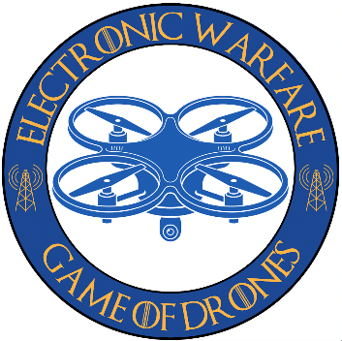

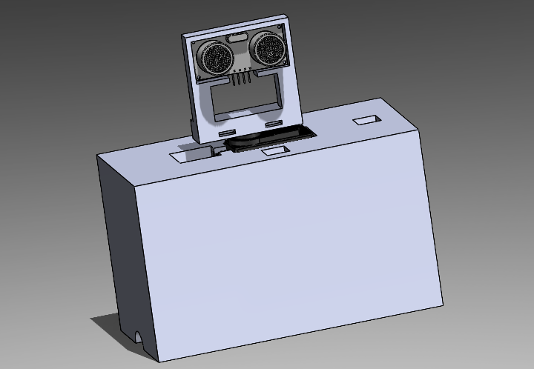
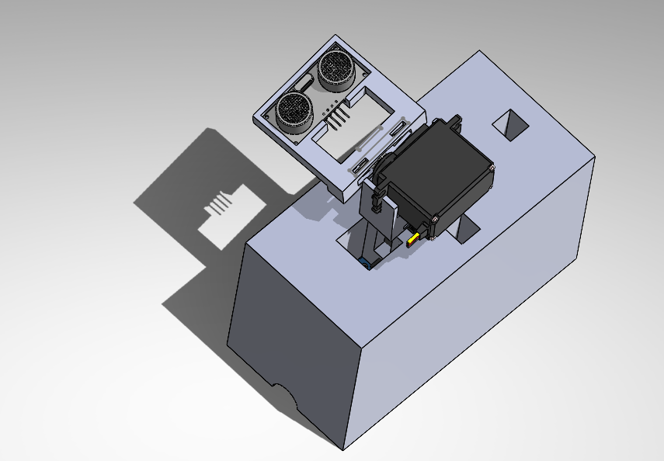
SoNAR Defensive Drone Detection in 2D & 3D Spaces (SoDDD 2DS & SoDDD 3DS)
Matthew Sieger | Chheavong (Michelle) Chheung, Stacy Eang, Gonzalo Figueroa, Brenden Stevens, and Alberto Izarraraz
Results / Accomplishments / Next Steps:
I demonstrated adaptability to underperforming parts and software incompatibilities. The 2D scanning system and 3D system have a 9x and 63x respective increase in detection area over the previous architecture.
The impact for the Navy is new capabilities for the Game of Drones program. New hires will have more setup options to detect enemies, akin to the variety of options in real-world settings.
What’s most important is that I collaborated with my peers to bolster my engineering capabilities and integrate my system into the GUI for the course.
In future, this project will be capable of mapping objects up to 30 feet away, as opposed to the current 8 feet limit. LiDAR will also enable more consistent detection of smaller drones.
Project Objective and Intern Contribution:
My aim was to learn how to design models in SolidWorks and apply advanced mathematics in a practical setting. I wanted to do this in a way that would drastically increase the area in which red team can detect enemy aircraft. The metrics of success were a 5x increase in detection area and <5% false positive for drone detection.
The methods I used to accomplish this aim were coding in C++, rapid prototyping using CAD, and collaboration with coworkers to overcome roadblocks.
My contributions were twofold: the CAD models to move the ultrasonic sensor and the code that governs the system. The CAD models connected the two servos to the ultrasonic sensor in a pan-tilt like system. The code controls the pan-tilt and calculates the location of the detected drone in spherical coordinates. It also filters out false positives by taking initial mappings of the surrounding environment.
Image Area
Takeaways:
The internship was valuable to me because I learned the steps to engineer a product from start to finish. I learned that projects often have multiple iterations before the desired result is achieved.
I am most proud that I gave Red Team a system that can detect enemies with >98% true positives when in 2D configuration. This greatly bolsters their defense against aggressors.
My parting advice is to find coworkers to contact during roadblocks and brainstorming. They make a large difference in one’s ability to quickly solve issues and their differing perspectives and approaches are invaluable.

